Slide 1

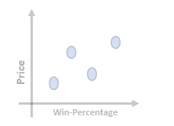
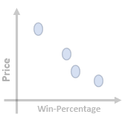
LIDL Case Study – Expanding Candy Offering
Ingredients contribution for win-percentage
What percent of each ingredient is contributing to win percentage
Pricing effect on winning strategy
Price has low correlation with Win-percentage, while there isn't a clear trend using overall data.
Positive Correlation with Price:
Products like "Twix," "Snickers," "Reese's Peanut Butter Cup," and "Kit Kat" have higher win percentages (81.64%, 76.67%, 84.18%, and 76.77% respectively) and also higher price percentages. This suggests that these products, despite being relatively expensive, are more popular among consumers.
Negative Correlation with Price:
Conversely, some products like “Super Bubble" and “One Dime" have high price percentages and lower win percentages (27.35% and 32.26% respectively). This implies that these products, despite being cheaper, are not popular among consumers.
Special Consideration for High-End Products:
High-end products like "Twix", "Reese's Peanut Butter Cup," "Snickers," and "Kit Kat" justify their higher prices with significantly higher win percentages. This suggests that consumers are willing to pay more for certain premium candy products.
More Ingredients
Products with more ingredients tend to have a higher price percentage.
The presence of popular ingredients like chocolate, caramel, peanuts, and crisped rice contributes to higher prices.
Premium ingredients, such as in the case of Twix, justify an even higher price.
Fewer Ingredients
Products with fewer ingredients, especially those with fruity flavours, tend to have relatively lower prices.
However, exceptions like Ring Pop demonstrate that few ingredients can have high pricing.
Implications for Product Development
For products with more ingredients, consider emphasizing quality and variety to justify a higher price point.
Products with fewer ingredients may target a different market segment seeking affordability.
Ingredients % composition used by top 5 candy products in the market
Choco | 100%
Fruity | 0%
Caramel | 40%
Peanuty | 60%
nougat | 20%
cripsed | 40%
hard | 0%
bar | 60%
pluri | 0%
sugar | 54.6%
price | 65.1%
Ingredients % composition for candy’s whose Win percent is > 68%
Choco | 90.4%
Fruity | 0.9%
Caramel | 33.3%
Peanuty | 38%
nougat | 19%
cripsed | 23%
hard | 0%
bar | 52.3%
pluri | 33.3%
sugar | 60.4%
price | 65.1%
Possible winning strategy
The popularity of specific ingredients (chocolate, caramel and peanuts) suggests that incorporating these into new product might be well-received.
This also suggest that combination of ingredients with textures might be appealing to consumers.
Optimal Pricing
Aim for a pricing strategy that falls within the optimal range, neither too high nor too low, to attract a broader consumer base.
Premium Options
If feasible, consider introducing a premium product with high-quality ingredients, as there seems to be a market for such products,
as evidenced by the success of premium candies like "Reese's Peanut Butter Cup" and "Kit Kat.“

Slide 2
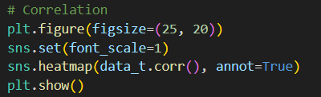

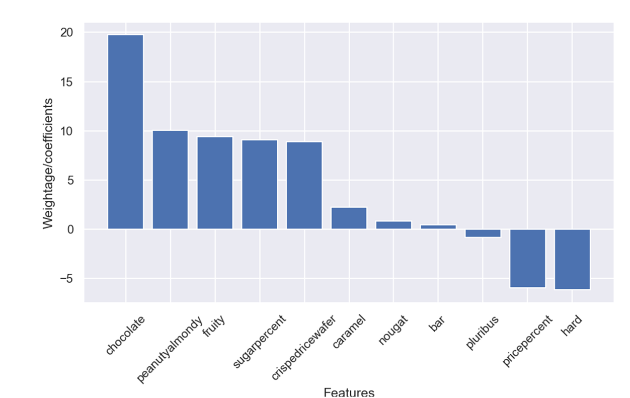
LIDL Case Study – Expanding Candy Offering
Approach
Understanding the data and detailed analysis on each features of the data.
Correlation between the features and each feature against win-percent
Reasoning for below questions using statistics
Ingredients influencing the winning strategy
Brand/Recipe/experience influence in high & low wins
Price analysis between More & Less ingredients
How pricing is effecting the winning strategy
Aim: Assess weightage of features on winning strategy.
Method: Fitted simple regression model on the data
Approx win-percentage equation using regression model
Win-percentage = 35.1 + ('chocolate'*19.7) + ('fruity’*9.4) + ('caramel’*2.22) + ('peanutyalmondy'*11.4)
+ ('nougat’*0.8) + ('crispedricewafer’*8.9) + ('hard'*-6.1) + ('bar’*0.4)
+ ('pluribus’*-0.8) + ('sugarpercent'*11.7) + ('pricepercent’*-5.9)

